Slide 1
Presentation on Kruskal’s Algorithm
Course no: CSE 2202
Course Title: Algorithms
Presented By:
Sk Nabil Sakif
Id: 170230
3rd year,2nd Term
Computer Science & Engineering Discipline
Khulna University,Khulna
Presented To:
Dr.Anupam Kumar Bairagi
Associate Professor
Computer Science & Engineering Discipline
Khulna University,Khulna
Date: 15 Oct 2019

Slide 2
Problem ::
Find the minimum cost using Kruskal’s algorithm that will build a minimum-cost
spanning tree from a graph of at least 10 nodes and corresponding weight in every edge.
ALGORITHM TO SOLVE THE PROBLEM::
1.First input the node & Edges Number
2.Input the corresponding nodes and weights
3.Apply Kruskal Algorithm
4.first sort the Edges on the basis of corresponding weights
5.check the Edges if there create any cycle or not
6.If there is no cycle then add the Edge to the output
7.Repeat 5 and 6 point until finished
8.Calculate the minimum cost for visiting every nodes

Slide 3
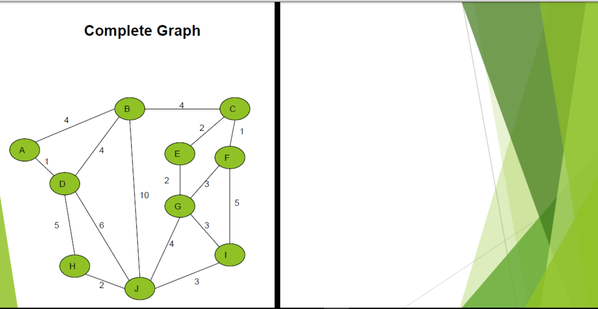

Slide 4
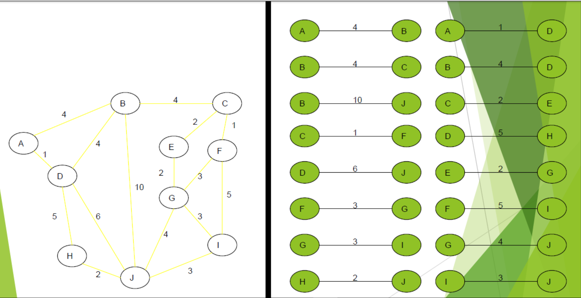

Slide 5
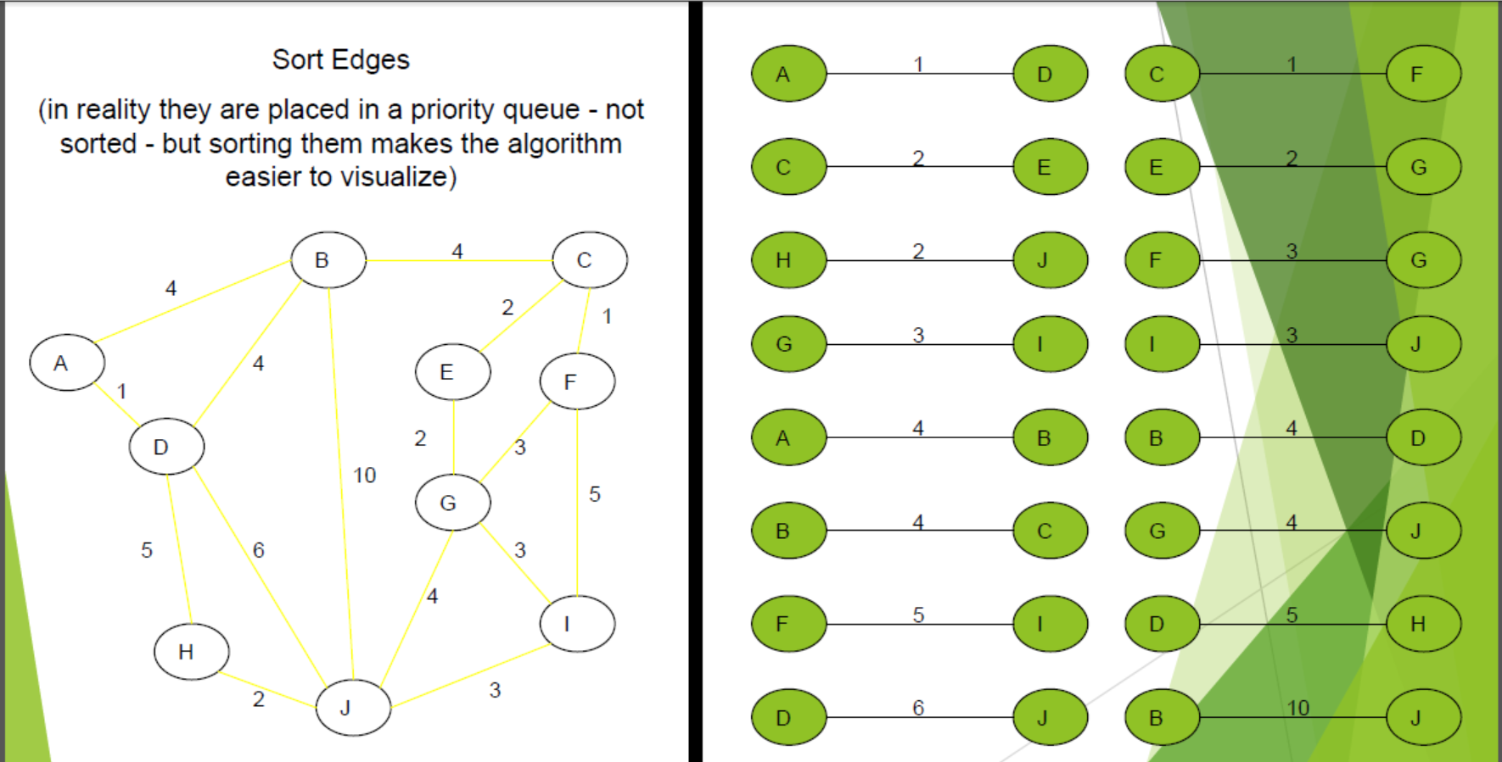

Slide 6
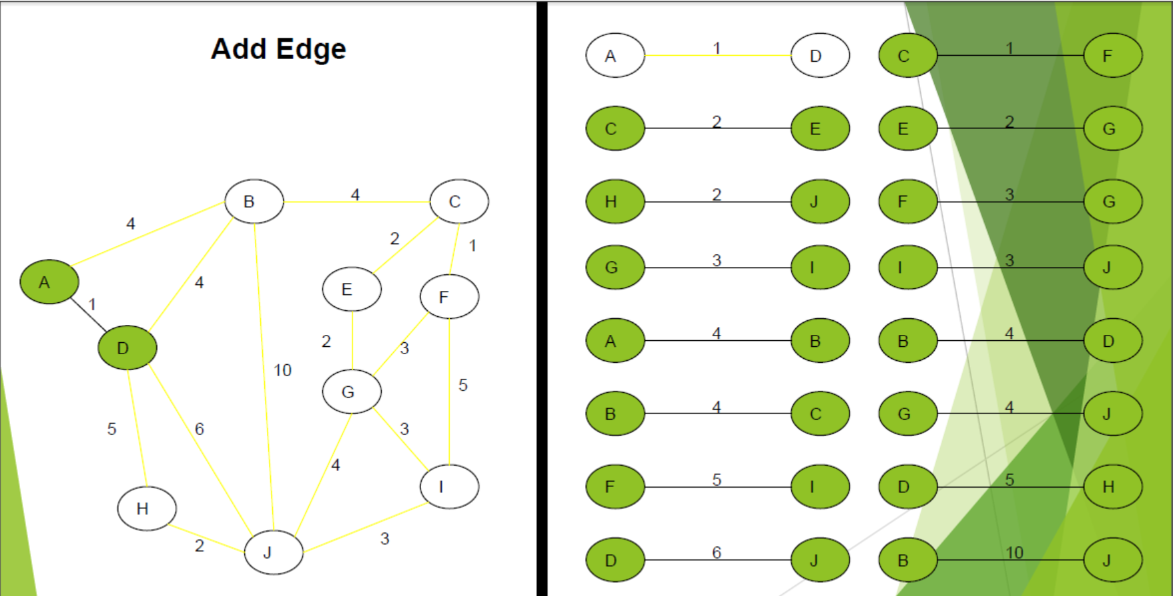

Slide 7
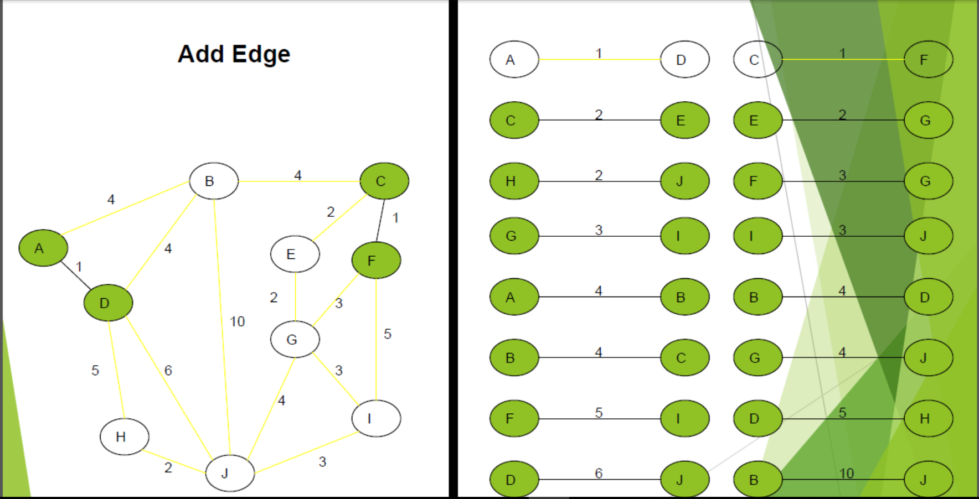

Slide 8
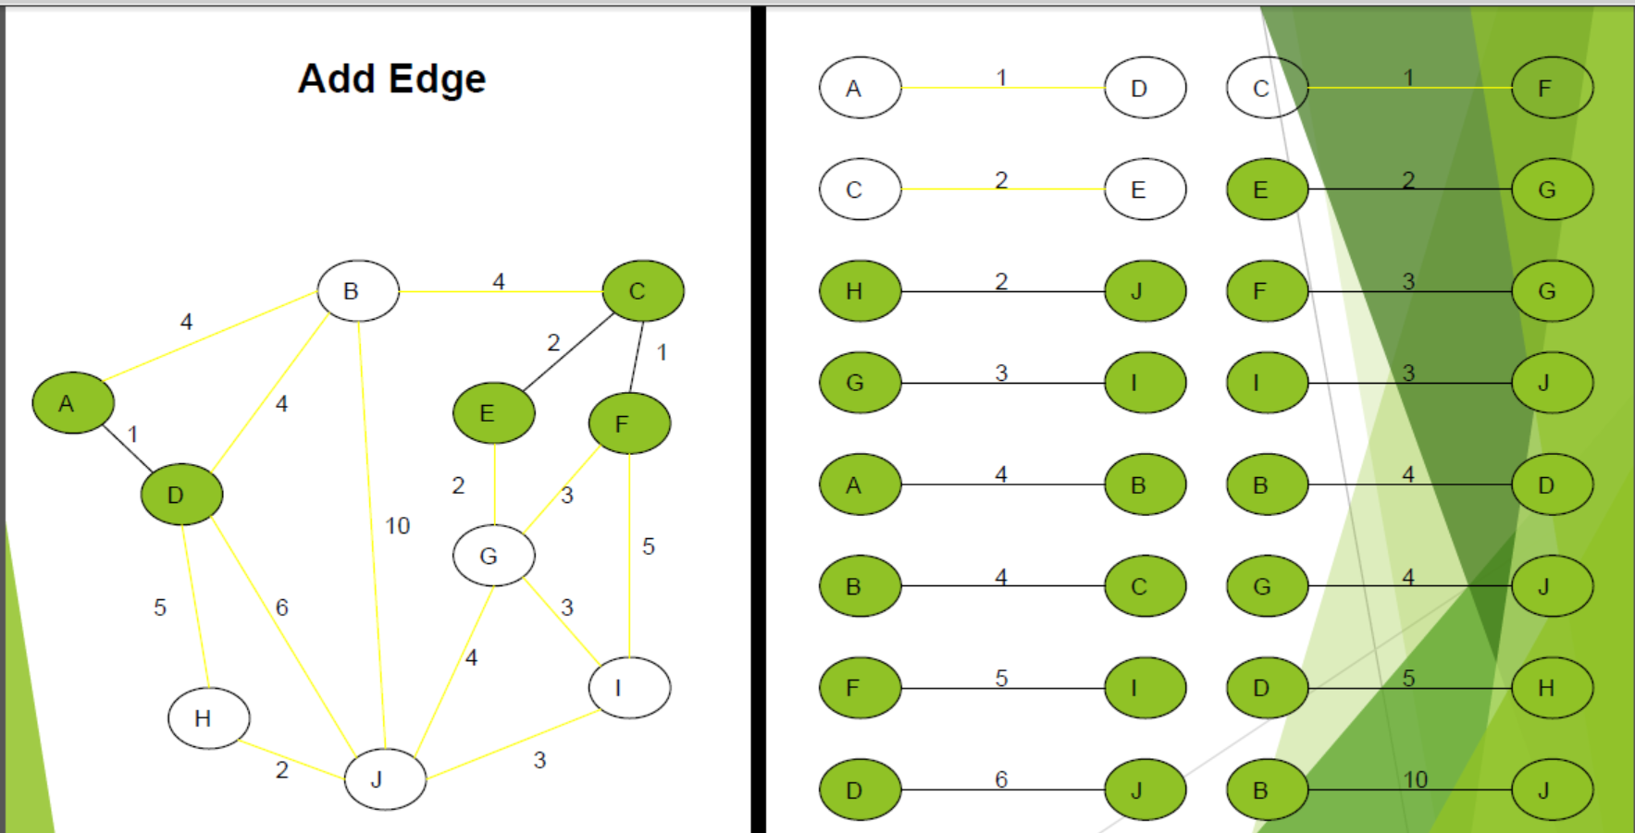

Slide 9
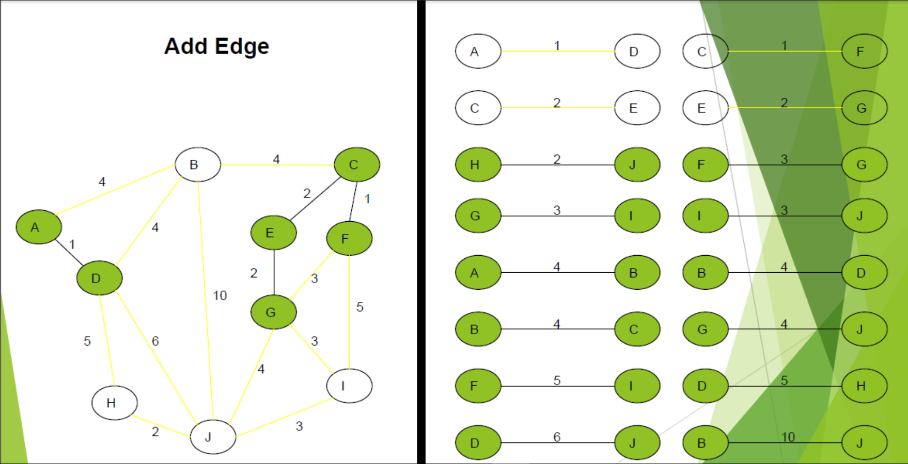

Slide 10
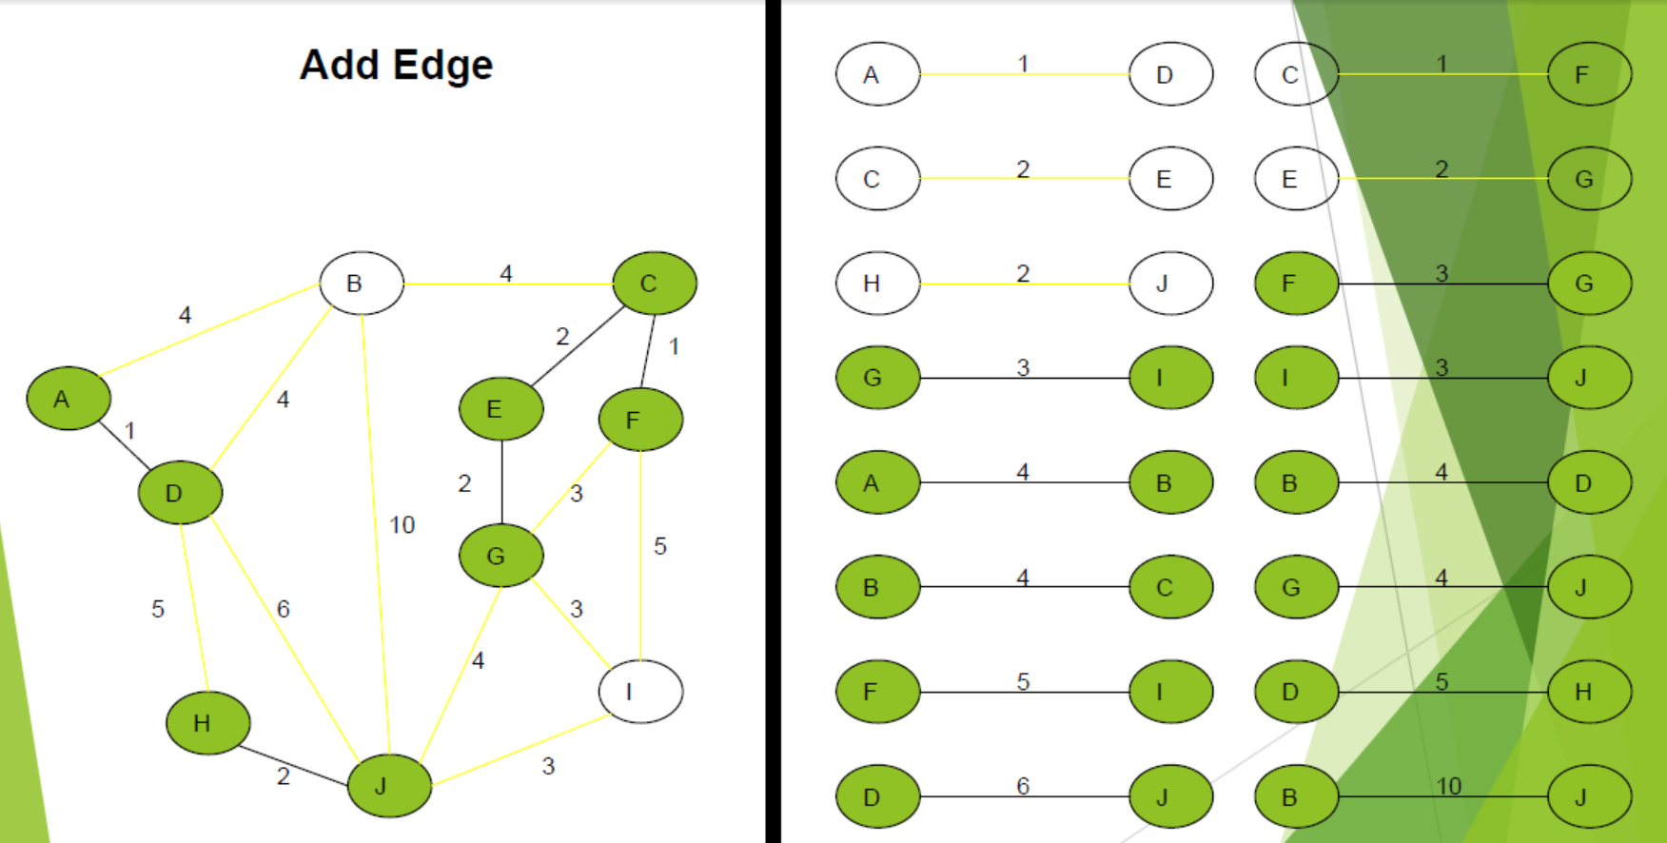

Slide 11
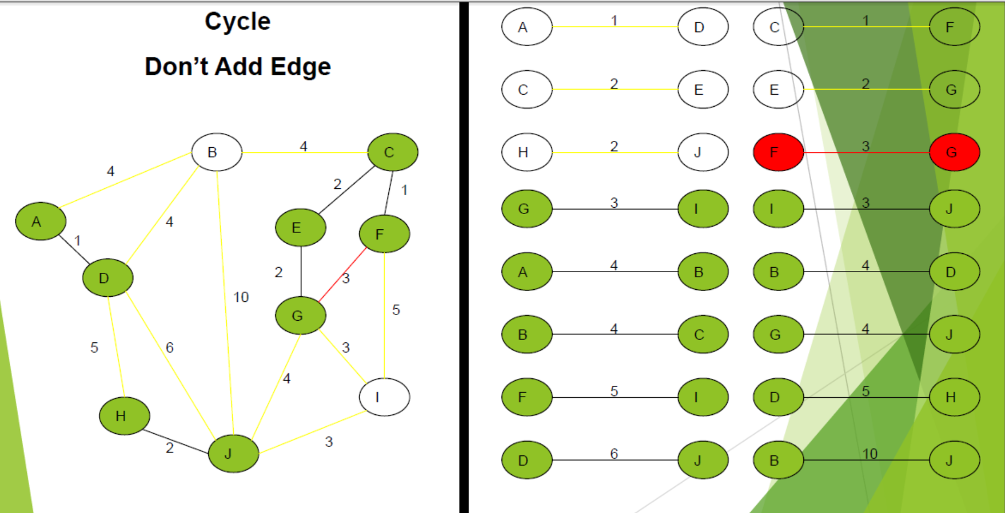

Slide 12
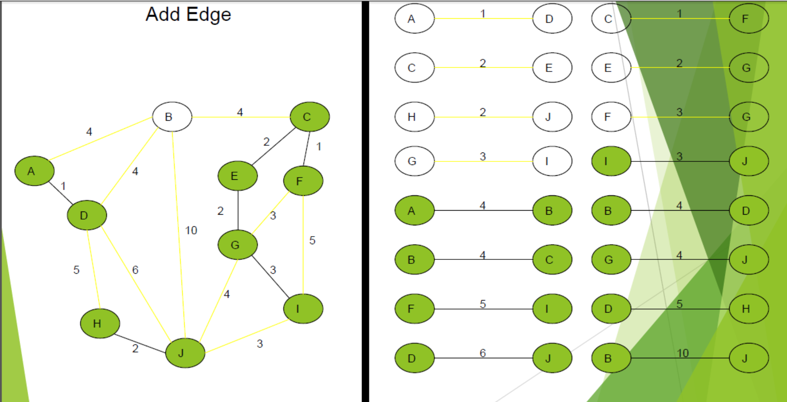

Slide 13
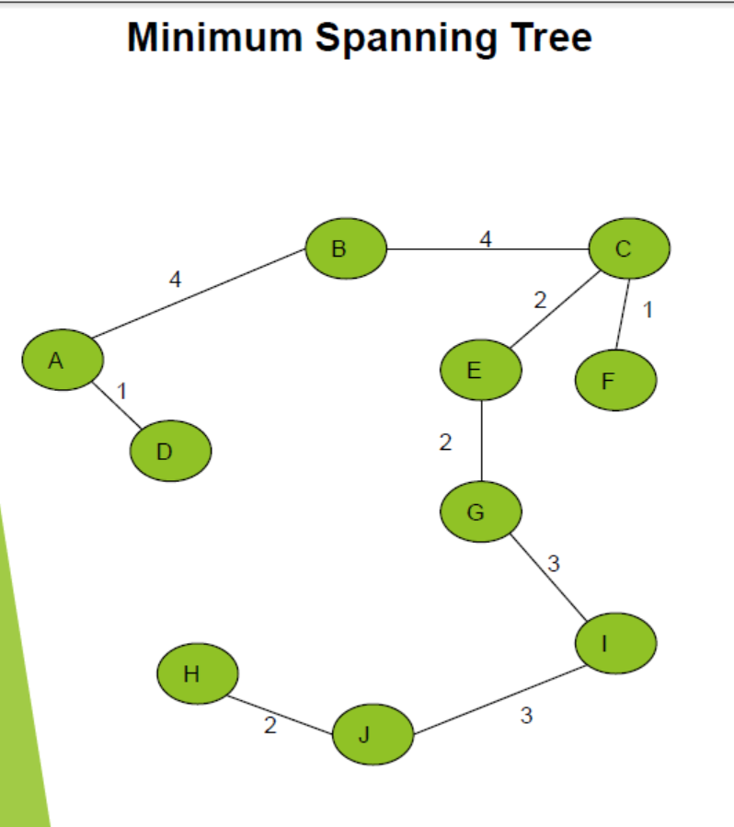

Slide 14
CODE::
#include<bits/stdc++.h>
using namespace std;
class Edge{
public:
int source;
int dest;
int weight;
};
bool compare(Edge e1,Edge e2)
{
return e1.weight<e2.weight;
}
int findParent(int v,int *parent)
{
if(parent[v]==v)
return v;
else findParent(parent[v],parent);
}
void kruskal(Edge *input,int n,int E)
{
sort(input,input+E,compare);

Slide 15
/// Sort the Edges in Ascending order
Edge *output=new Edge[n-1];
int *parent=new int[n];
for(int i=0;i<n;i++)
{
parent[i]=i;
}
int count=0,i=0,mst=0;
while(count != n-1)
{
Edge currentEdge=input[i];
///union find Algorithm
///check of we can add the edge in MST or NOT
///cycle finding with checking the currrentEdge parent
int sourceParent=findParent(currentEdge.source,parent);
int destParent=findParent(currentEdge.dest,parent);
if(sourceParent!=destParent)
{
output[count]=currentEdge;
count++;
parent[sourceParent]=destParent;
}
i++;
}

Slide 16
cout<<"The Shortest Path is: "<<endl;
for(int i=0;i<n-1;i++)
{
if(output[i].source<output[i].dest)
{
cout<<output[i].source<<" "<<output[i].dest<<" "<<output[i].weight<<endl;
}
else
{
cout<<output[i].dest<<" "<<output[i].source<<" "<<output[i].weight<<endl;
}
mst+=output[i].weight;
}
cout<<"Minimum Cost Spanning Tree is : "<<mst<<endl;
}

Slide 17
int main()
{
cout << "Enter Number of Nodes & Edges" << endl;
int n,E;
cin>>n>>E;
Edge *input=new Edge[E];
cout<<"Enter The Matrix: "<<endl;
for(int i=0;i<E;i++)
{
int s,d,w;
cin>>s>>d>>w;
input[i].source=s;
input[i].dest=d;
input[i].weight=w;
}
kruskal(input,n,E);
return 0;
}

Slide 18
Input::
Enter Number of Nodes & Edges
10 14
Enter The Matrix:
0 1 10
0 2 6
2 3 5
0 3 5
1 3 15
1 4 2
4 6 9
3 6 8
4 5 24
5 7 6
6 7 10
2 8 4
3 9 6
8 9 4

Slide 19
Output::
The Shortest Path is:
1 4 2
2 8 4
8 9 4
2 3 5
0 3 5
5 7 6
3 6 8
4 6 9
6 7 10
Minimum Cost Spanning Tree is : 53
--------------------------------

Slide 20
Questions?

Slide 21
THANK YOU

